Slide 1
Concepts for an Informed Health Care Conversation
U.S. HEALTH CARE FINANCING
Wildbluehealthsolutions.com
Ken Janda - January, 2020

Slide 2
About Ken
Principal, Wild Blue Health Solutions, a strategic consultancy taking on challenges in health care.
Adjunct professor at University of Houston College of Medicine and Jones Business School, Rice University
Former CEO of non-profit health insurer Community Health Choice, focused on low-income populations
Over 25 years experience with national health insurers Prudential, Aetna, Humana
Health policy wonk (Rice University, Texas Medical Center, Center for Public Policy Priorities and more)
B.A. Rice University; J.D. U of H Law Center
Native Texan…small town roots and values
Husband, father of two and grandfather of four
Community board volunteer (San Jose Clinic, Christ Clinic and others)
Common sense conservative, practical progressive
Huge baseball fan. Still loves the Astros.
Ken.Janda@wildbluehealthsolutions,com

Slide 3
US Spends More than Other Countries
Health Care Resources
….but Gets Less
Lowest
Highest
Health Spending
OECD ($3,994)
$1,138
Health Spending Share
United States
($10,586)
OECD (8.8 Per 1000)
4.2
United States (16.9 Per 1000)
Access to care
Bottom Performer
Top Performer
Population Coverage
OECD (98%)
89
100
United States (91%)
Financial Protection
OECD (71.2%)
85.5
30.5
United States (50.2%)
Source: OECD Health at a Glance 2019, 36 countries
Notes:
See comment on this slide. Need 2019 data and refresh.

Slide 4
US Spends More than Other Countries
Health Status
….but Gets Less
Bottom Performer
Top Performer
Life Expectancy
OECD (80.7 Years)
74.8
84.2
United States (78.6 Years)
Avoidable Mortality
OECD (208 Per 100 000)
426
125
United States (262 per 100 000)
Chronic disease morbidity
13.1%
3.3%
United States (10.8%)
OECD (6.4%)
Self-rated health
OECD (8.7%)
17.0%
2.3%
United States (2.6%)
Source: OECD Health at a Glance 2019, 36 countries
Notes:
See comment on this slide. Need 2019 data and refresh.

Slide 5
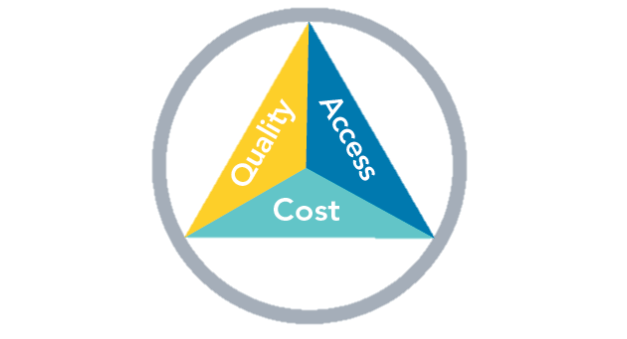
The Health Care Triple Aim: Simultaneous improvements
IMPROVING THE HEALTH OF POPULATIONS
REDUCING PER CAPITA COSTS OF HEALTH CARE FOR POPULATIONS
IMPROVING THE INDIVIDUAL EXPERIENCE OF CARE
http://www.ihi.org/Engage/Initiatives/TripleAim/Pages/default.aspx
Notes:
Find link to IHI website for more info

Slide 6
Health ≠ Health Care ≠ Health Insurance
GOAL
HEALTH
Individual and Population, measured by both length and quality of life
HEALTHCARE SERVICES
PERSONAL BEHAVIORS
SOCIOECONOMIC FACTORS
PUBLIC
HEALTH
CONTRIBUTORS
Access and Quality
Doctors
Hospitals
Pharmacies
Ancillary Services
Education
Employment
Housing
Community Safety
Transportation
Food Security
Water Sanitation
Environment
Communicable
Diseases
Immunizations
Tobacco Use
Diet and Excercise
Alcohol/Drug use
Sexual Activity
SUPPORTED BY MEDICAL EDUCATION AND RESEARCH
FINANCED BY
HEALTH INSURANCE
80%
PERSONAL PAYMENT
20%
? INDIGENT,
UNINSURED
BAD DEBT ?
FUNDED BY
Government
Employers
Individuals
Government
Private Philanthropy
Individuals (e.g. Education)
INSURANCE COMPANIES?
Notes:
I made this one up. Should we find a version that has a reputable academic reference.

Slide 7
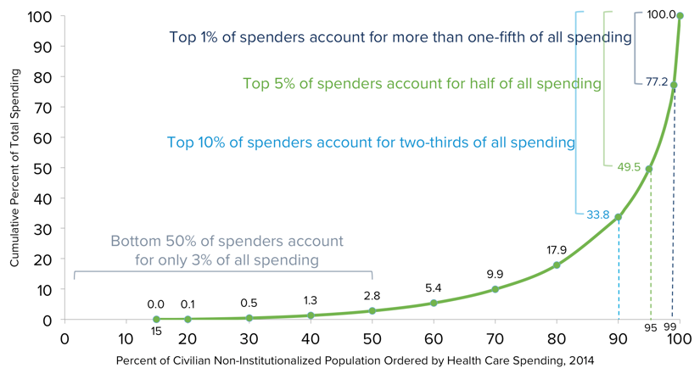
Health Care Spending is Highly Concentrated
NIHCM Foundation analysis of data from the 2014 Medical Expenditure Panel Survey

Slide 8
Health Insurance is Critical
Expensive and you never know when you’ll need high-cost care
Insurance is access to health care providers
Protect assets (if you are lucky enough to have assets to protect)
Insurance facilitates care coordination
Everyone needs coverage!
Health insurance is important tool, but not the goal…
HEALTH
Notes:
Re-work this slide

Slide 9
Who Pays for Our Health Care? $3.6 trillion annually under current law
Medicare
Households
Federal Government
$931 billion
$1.28 trillion
Medicaid/CHIP
Employers
$955 billion
State Governments
$931 billion
Source: https://www.kff.org/health-reform/slide/current-status-of-the-medicaid-expansion-decision/
US Health Care Spending in 2020 from NY Times Upshot

Slide 10
Health Insurance is Complicated
Predominant Coverage by Age and Income
>400%
Private/Employer
Sponsored Coverage
400%
ACA/Marketplace
Premium
Subsidies
250%
200%
Premium
and
Cost Sharing
Subsidies
Federal Poverty Level (FPL)
CHIP
Medicare
Medicaid LTC
100%
Medicaid
Texas Coverage Gap (Uninsured)
(and most County Indigent Care Programs)
0%
Newborns
(<1 year)
Children
(Ages 1-18)
Pregnant
Women
Parents*
Childless
Adults
Disabled
Over Age 65
(>65 year)

Slide 11
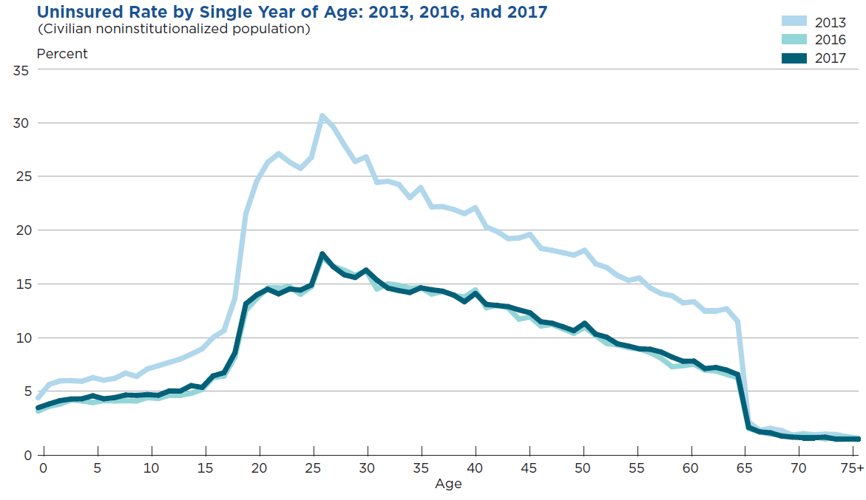
Uninsured Rates Vary by Age ACA drove big decrease, 2013-2017
Source: https://www.census.gov/content/dam/Census/library/publications/2018/demo/p60-264.pdf
Notes:
I wouldn’t put this in here but I just wanted to give the option. It’s a neat graph.

Slide 12
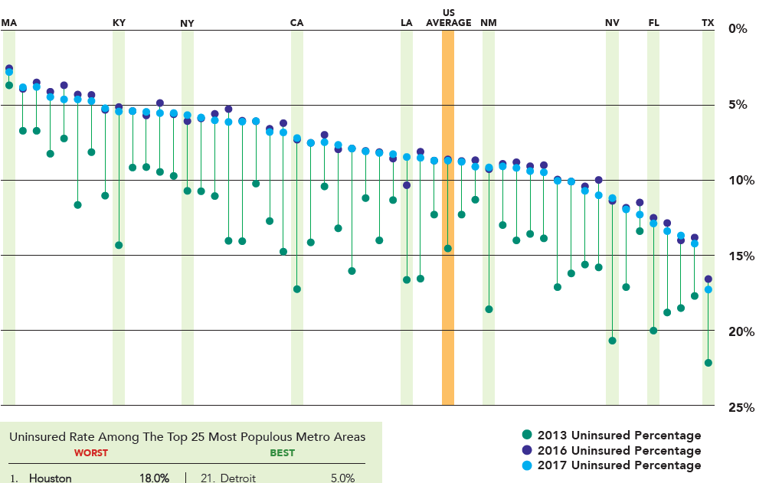
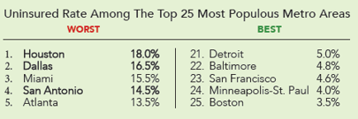
Uninsured Rates Vary by State
2013-2017
TX
Texas dead last by A LOT!
Source: https://www.census.gov/content/dam/Census/library/publications/2018/demo/p60-264.pdf
Notes:
I wouldn’t put this in here but I just wanted to give the option. It’s a neat graph.

Slide 13
5 Million Uninsured Texans
2.7 Million low-wage Texans and their families
NOT offered or NOT eligible for employer insurance
1.3 Million Adults
could be covered under a Medicaid expansion
300K are Currently Eligible
NOT enrolled in Medicaid
700K undocumented working immigrants

Slide 14
Insurance Matters Health Outcomes by State Some in TX say it’s OK to have 5 million uninsured.
Better performance
HI
MA
MN
Strong correlation between outcomes and insured rates
WA
CT
VT
RI
IA
CO
NH
UT
WI
ME
CA
NY
ND
OR
ID
MD
NJ
PA
NE
DC
SD
MI
MT
DE
IL
U.S. AVERAGE
MT
VA
AK
KS
AZ
OH
NC
NM
IN
IN
AL
TN
KY
SC
GA
MO
FL
LA
WV
AR
NV
TX
OK
MS
Texas is 48th in composite of 47 indicators
Worse performance
States are arranged in rank order from left (best) to right (worst), based on their overall 2019 State Scorecard rank.
Source: Commonwealth Fund 2019 State Rankings on Health System Performance
Notes:
I wouldn’t put this in here but I just wanted to give the option. It’s a neat graph.

Slide 15
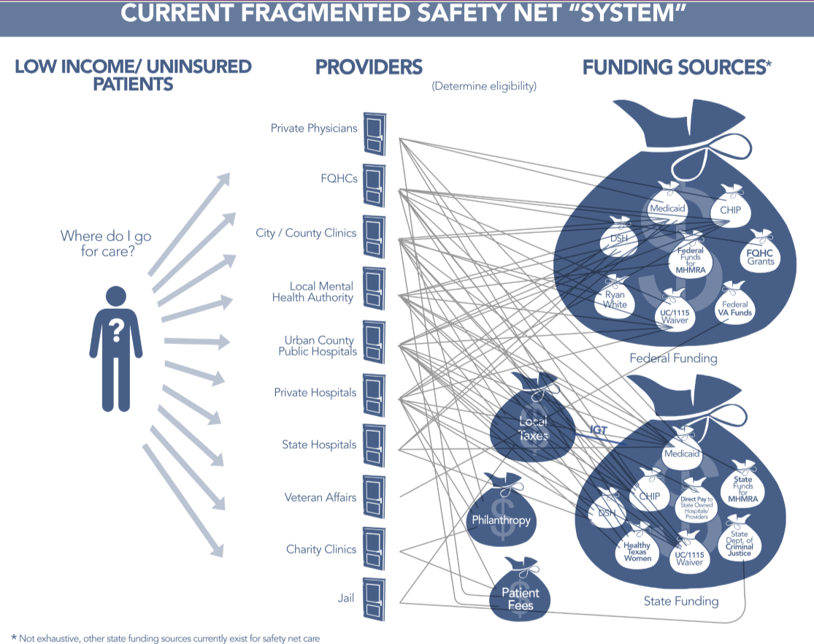
We Pay for the Uninsured: It’s a Mess (Coverage is Better)
For 1.3 million eligible for Medicaid expansion, coverage would:
- draw down more federal dollars
- save the state money (90/10 match)
- reduce administrative burden
- produce better outcomes

Slide 16
What Are Our Goals? A Health Policy Home Run
Simplify Funding and Administration of Programs
Reduce administrative burden through consistent program administration across Medicare, Medicaid, and private plans
Reduce complex supplemental provider funding in government programs
Integration/interoperability of systems
Coverage for Everyone
A basic benefit plan for all based on age, income, disability
Choices and ability to “buy up” for additional services
Everyone in the pool
Subsidies based on age and income
Slow Cost Increases through Provider Payment Reform
Encourage coordinated, less fragmented care (medical homes, ACOs, etc.)
Restructure provider payments to reward efficiency and quality (value-based payments)
Assure fair payment rates across programs and providers, incl Rx
Personal & Community Accountability for Health
Healthy behaviors
Choices, transparency and consumerism
Everyone pays something: based on income
Community/social influences
Notes:
Needs some rewording

